Slide 1
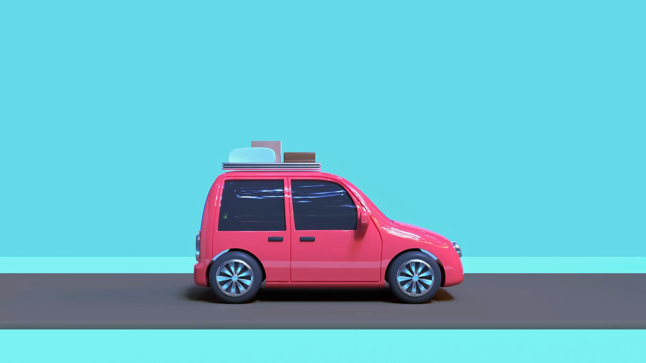
Indian Driving Dataset A Multi-label Problem
ML2 Final Project – Group 2
Hemangi Kinger
Varun Shah
Ishan Kuchroo

Slide 2
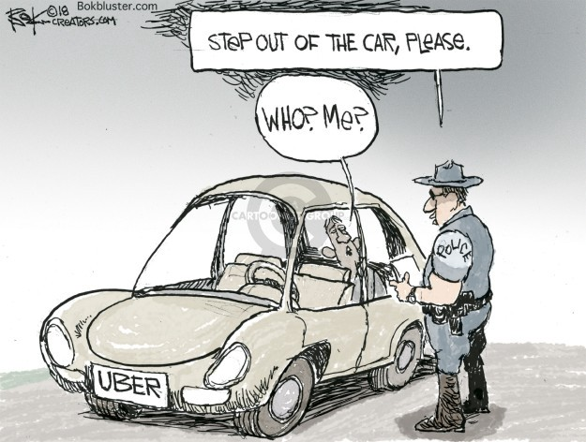
Use Case

Slide 3
Autonomous Driving in India
While several datasets for autonomous navigation have become available in recent years, they have tended to focus on structured driving environments
All the available open data sets are recorded in western setting, where lanes are wide, and signs & dividers are well-defined.
But for AI algorithms to learn, Indian roads are a lot harder than western roads, as there isn’t enough data on Indian road conditions.
Algorithms trained on western data sets, like Sully Chen’s Driving Data, Comma.ai Research Data, Baidu’s Apollo Open Platform etc. may not perform well in Indian conditions.
Indian Driving Dataset consists of images obtained from a front facing camera attached to a car.
The car was driven around Hyderabad, Bangalore cities and their outskirts for road scene understanding in unstructured environments where the above assumptions are largely not satisfied

Slide 4
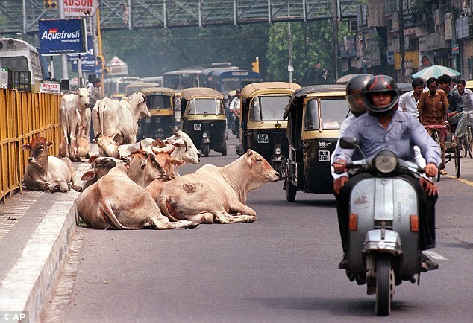
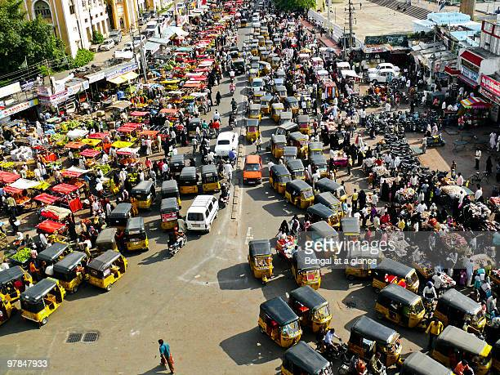
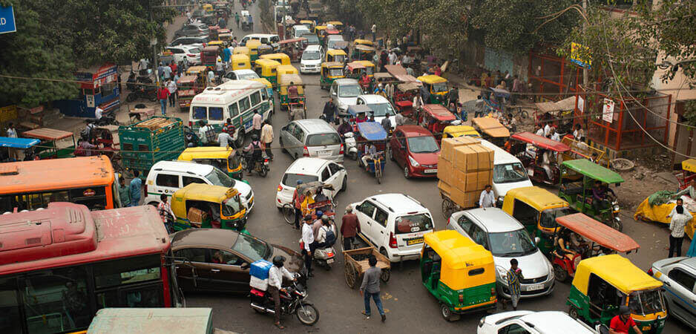

Slide 5

Image Classification Problem
Image classification refers to a process in computer vision that can classify an image according to its visual content.
Structure for performing Image Classification
Image Pre-processing:
Process to improve the image data (features) by suppressing unwanted distortions and enhancement of some important image features.
Includes Resizing image, and Data Augmentation (Gray scaling of image, Reflection, Gaussian Blurring, Histogram, Equalization, Rotation, and Translation).
Detection of an object:
Detection refers to the localization of an object which means the segmentation of the image and identifying the position of the object of interest.
Feature extraction and training:
Use statistical or deep learning methods to identify the interesting patterns of the image that will help the model to differentiate between different classes.
This process where the model learns the features from the dataset is called model training.
Classification of the object:
This step categorizes detected objects into predefined classes by using a suitable classification technique that compares the image patterns with the target patterns.

Slide 6
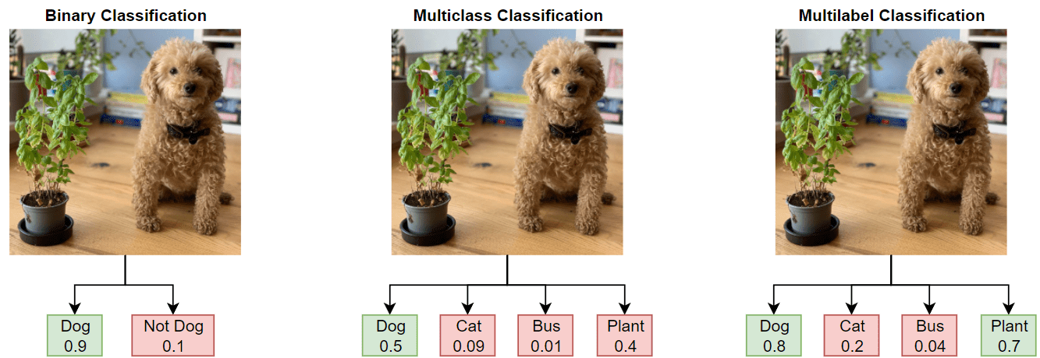
Types of Classification

Slide 7

Loss Function
In supervised learning, there are two main types of loss functions — these correlate to the 2 major types of neural networks:
regression - Ex. Mean Squared Error, Mean Absolute Error
classification - Ex. Binary Cross-Entropy, Categorical Cross-Entropy
Binary Cross-Entropy/Log Loss:
This is the loss function used in binary classification models — where the model takes in an input and must classify it into one of two pre-set categories.
The model outputs a vector of probabilities that the input image belongs to each of the pre-set categories.
This output is then compared to the actual output, represented by a vector of equal size, where the correct category has a probability of 1 and all others have a probability of 0.
Categorical Cross-Entropy Loss:
Categorical cross entropy or sparse categorical cross-entropy have the same loss function as Binary Cross-Entropy.
The only difference is that for Categorical cross-entropy is used when true labels are one-hot encoded,
The most used loss function in image classification is cross-entropy loss/log loss (binary for classification between 2 classes and sparse categorical for 3 or more), where the model outputs a vector of probabilities that the input image belongs to each of the pre-set categories

Slide 8
Metric
Accuracy:
Accuracy is the proportion of examples that were correctly classified. More precisely, it is sum of the number of true positives and true negatives, divided by the number of examples in the dataset.
In multi-label classification, a misclassification is no longer a hard wrong or right
Hamming Loss
The fraction of the wrong labels to the total number of labels
Method: exclusive or (XOR) between the actual and predicted labels and then average across the dataset
In multi-label classification, hamming loss penalizes only the individual labels
Lower the Hamming loss better the model performance

Slide 9
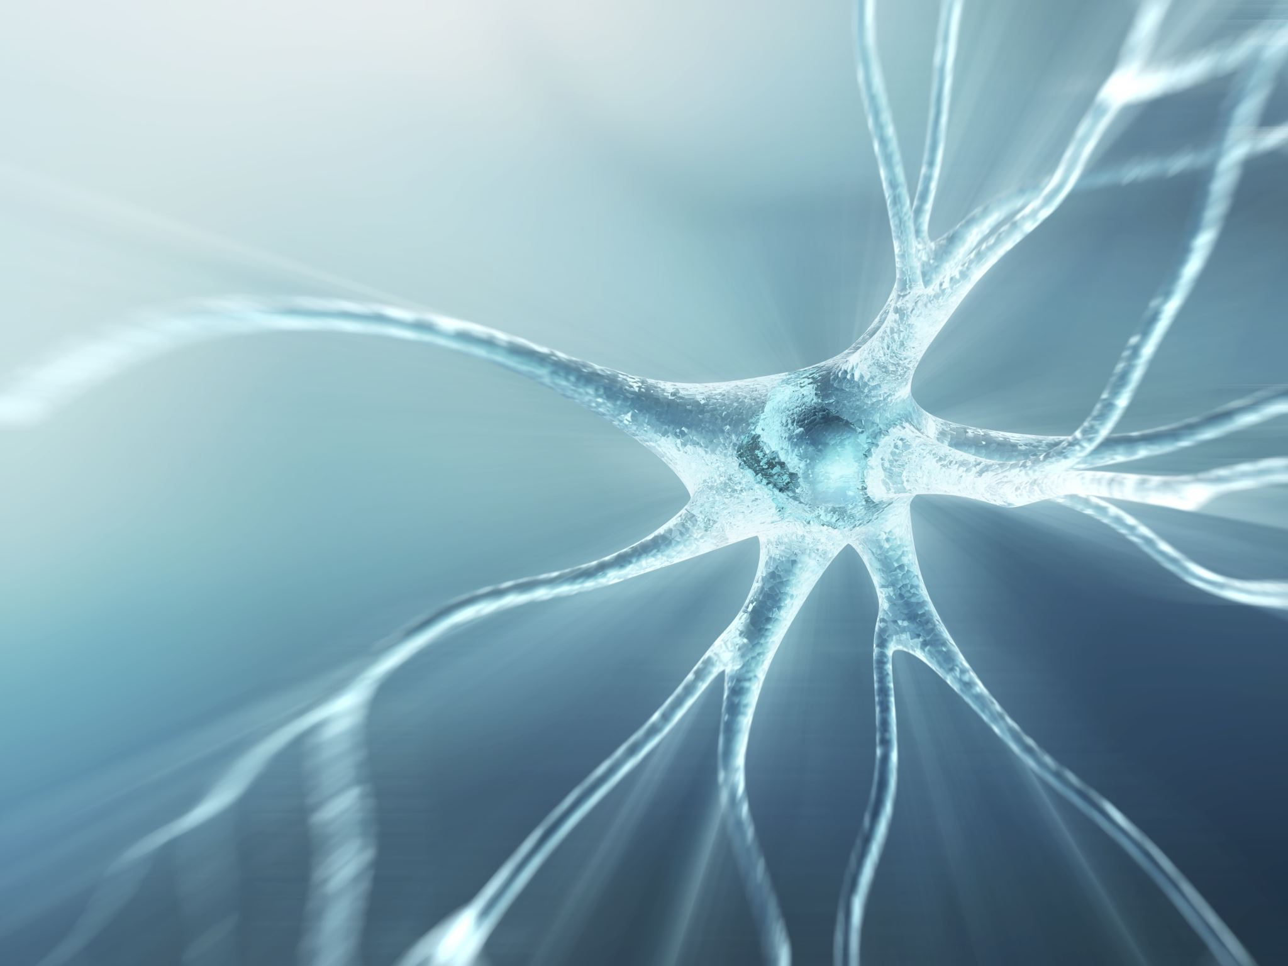
Neural Networks

Slide 10
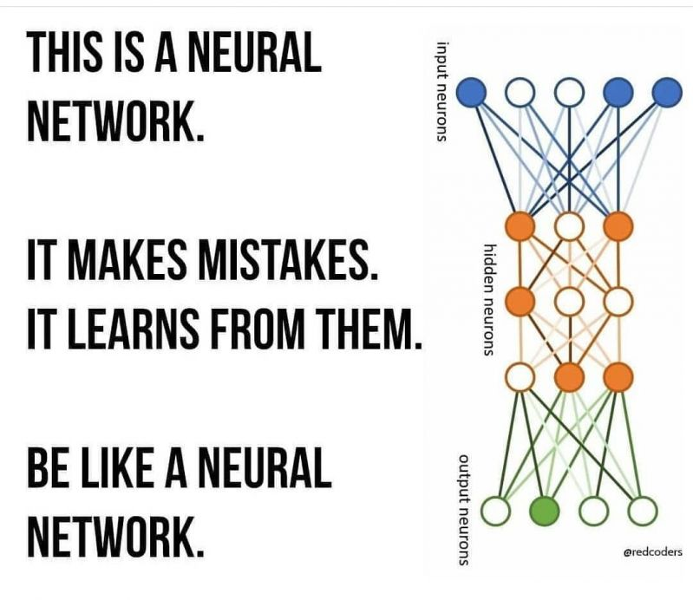
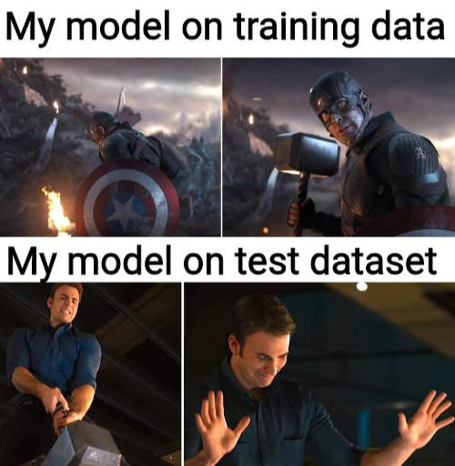
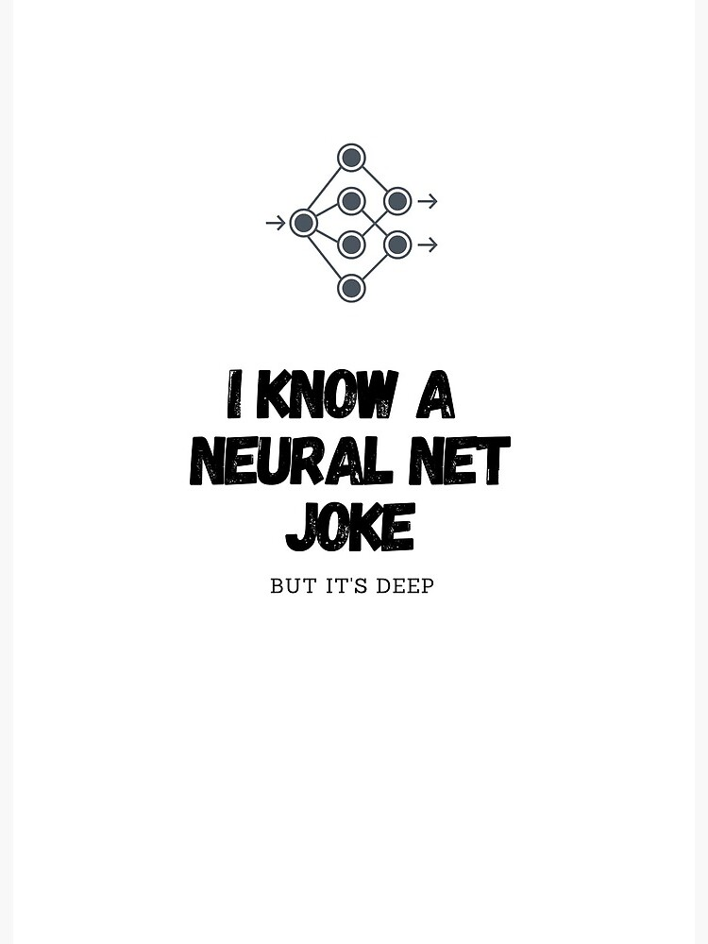
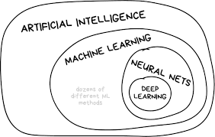
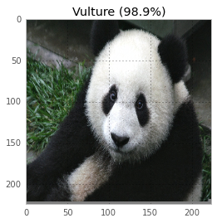
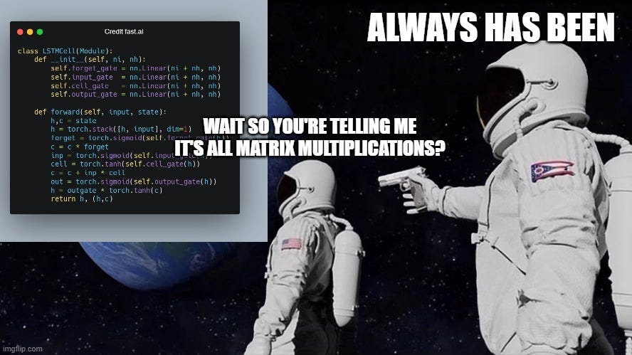
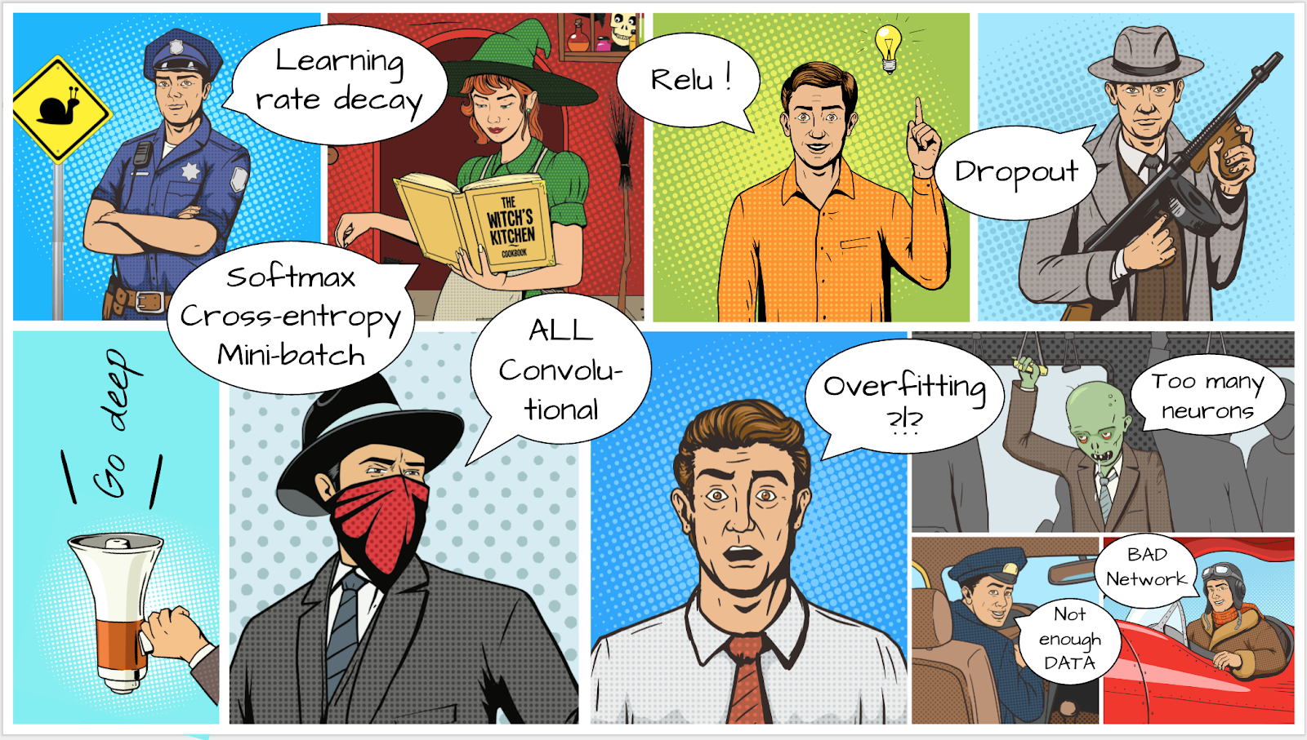
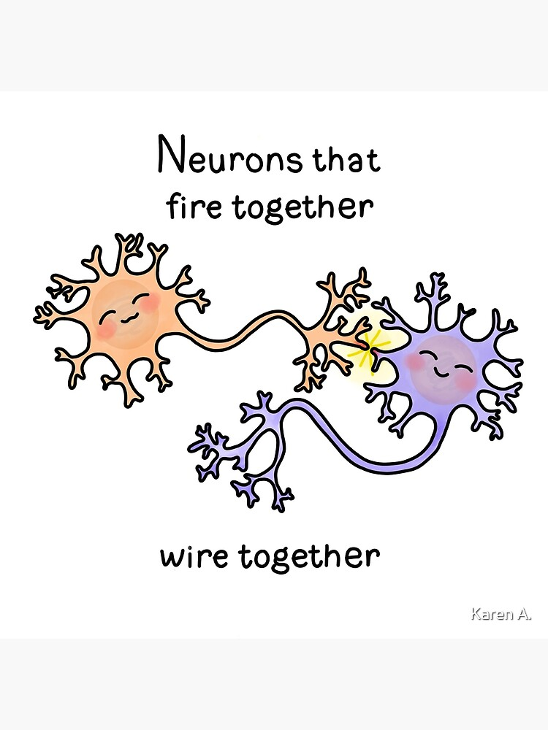

Slide 11

Convolution Neural Networks (CNN)
A Convolutional Neural Network (ConvNet/CNN) is a Deep Learning algorithm that can take in an input image, assign importance (learnable weights and biases) to various aspects/objects in the image, and be able to differentiate one from the other

Slide 12
Model Journey
Simple Conv2D
ResNet
EfficientNet
AlexNet
VGG16
MobileNet
NFNet
RegNet
MLPMixer
Vision Transformers (ViT)

Slide 13
ResNet - 101
ResNet (Residual Network) is a convolutional neural network that democratized the concepts of residual learning and skip connections
Skip connections technique solves the problem of vanishing gradient in deep CNNs by allowing alternate shortcut path for the gradient to flow through.
Also, the skip connection helps if any layer hurts the performance of architecture, then it will be skipped by regularization.
The layers in a traditional network are learning the true output whereas the layers in a residual network are learning the residual. Hence, the name: Residual Network.
This network has 101 layers

Slide 14
Efficient Net
Efficient Net is a convolutional neural network architecture and scaling method that uniformly scales all dimensions of depth, width, or resolution using a compound coefficient.
The compound scaling method is justified by the intuition that if the input image is bigger, then the network needs more layers to increase the receptive field and more channels to capture more fine-grained patterns on the bigger image
This is based on a modular architecture

Slide 15
Reg Net
Reg-Net is not a single architecture, it is a design space defined as a regulatory module for ResNet
Based on concept of using a Bottleneck Residual Block
1. A variant of the residual block that utilizes 1x1 convolutions to create a bottleneck.
2. Reduces the number of parameters and matrix multiplications to increase depth
Note: The quantization function is represented as a linear combination of several Sigmoid functions with learnable biases and scales that could be learned in a lossless and end-to-end manner via continuous relaxation of the steepness of Sigmoid functions

Slide 16
Data Overview
Overview:
IDD consists of images, finely annotated with 16 classes collected from 182 drive sequences on Indian roads.
The label set is expanded in comparison to popular benchmarks such as Cityscapes, to account for new classes.
It also reflects label distributions of road scenes significantly different from existing datasets, with most classes displaying greater within-class diversity.
Consistent with real driving behaviors, it also identifies new classes such as drivable areas besides the road.
The dataset is inspired from the one used in the 2018 paper IDD: A Dataset for Exploring Problems of Autonomous Navigation in Unconstrained Environments
Source:
http://idd.insaan.iiit.ac.in/dataset/details/
Splits:
The dataset of 9860 images has been split into train, validation and test sets with each set having 6,991, 1912 and 957 images, respectively.

Slide 17
Fine-Tuning Networks
In finetuning: we start with a pretrained model and update all the model’s parameters for our new task, in essence retraining the whole model
Image Augmentation:
Resize
Rotate
Horizontal/Vertical-Flip
Random Brightness/ Contrast
Parameters modified:
Learning Rate
Batch Size
Epochs
Image Size
Optimizer

Slide 18
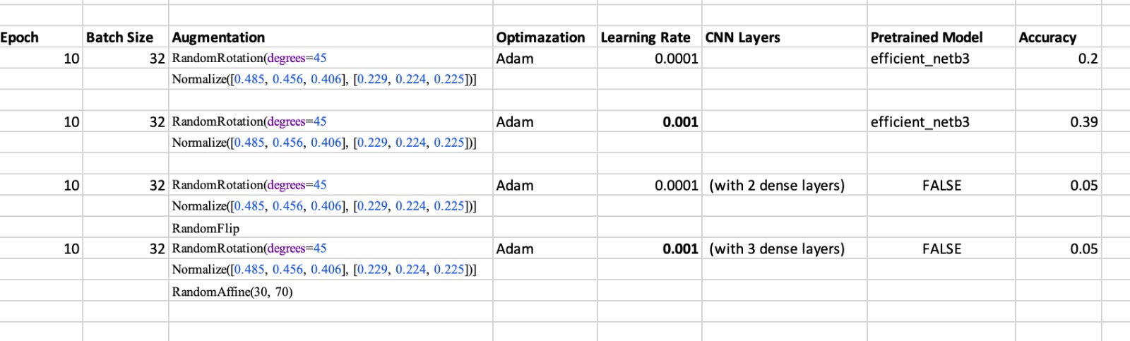
Fine-tuning (contd.)

Slide 19
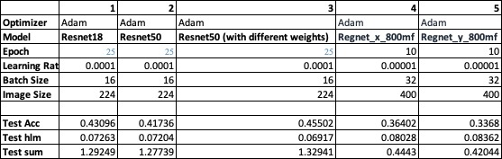
Fine-tuning (contd.)

Slide 20
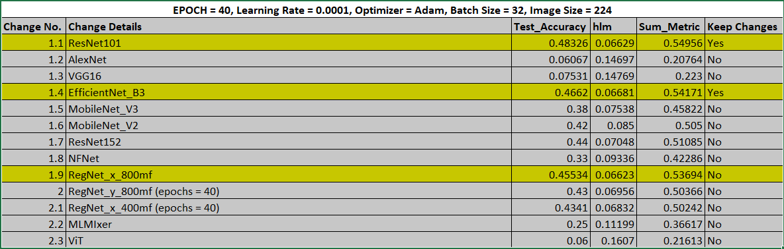
Fine-tuning (contd.)

Slide 21
Results
Loss/ Accuracy/ Hamming Loss

Slide 22
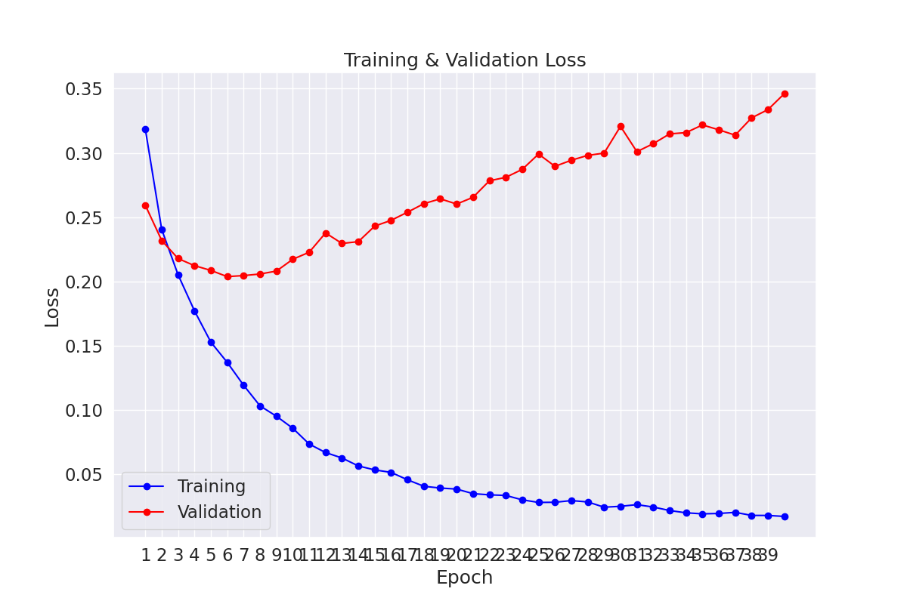
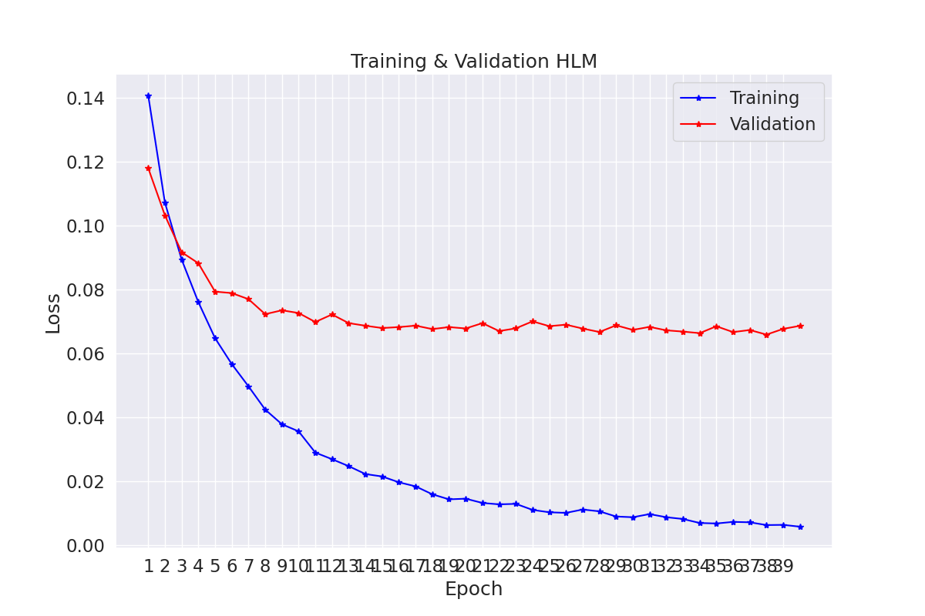
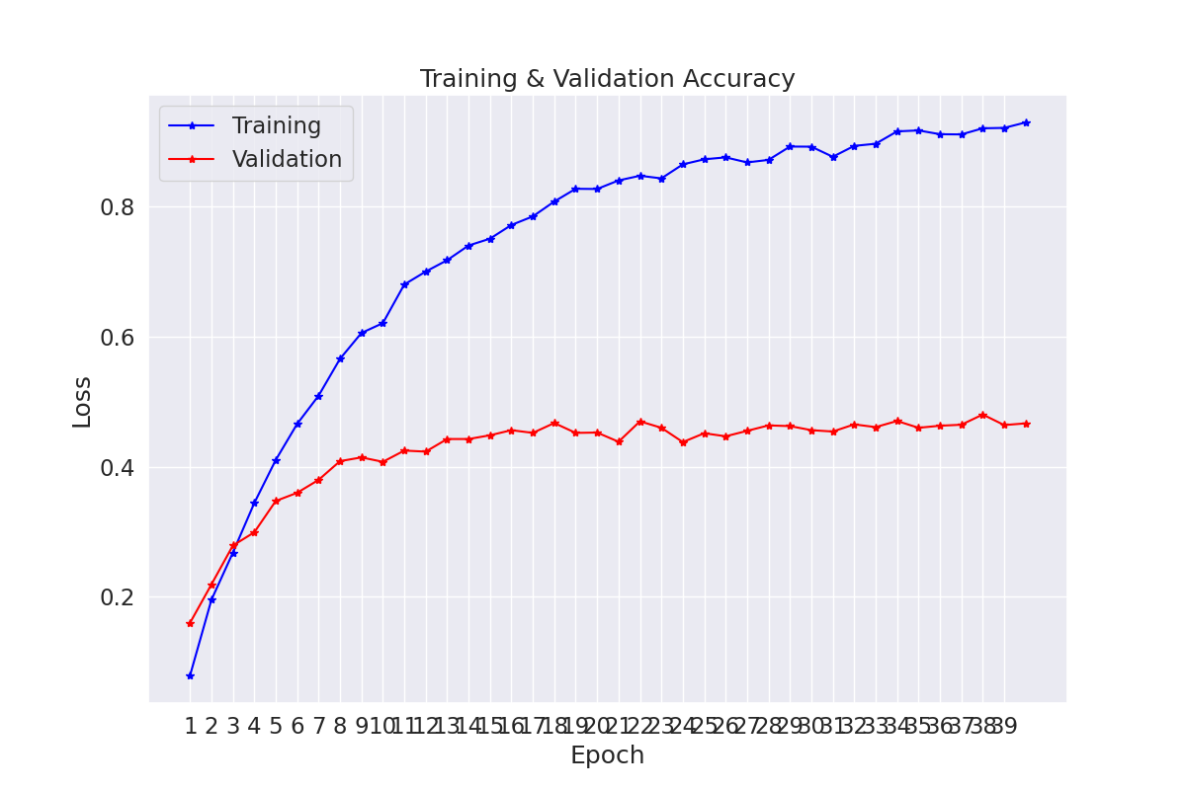
ResNet - 101
Test Accuracy: 48% and Test Hamming: 0.06629
Average Individual Class – F1: 0.72

Slide 23
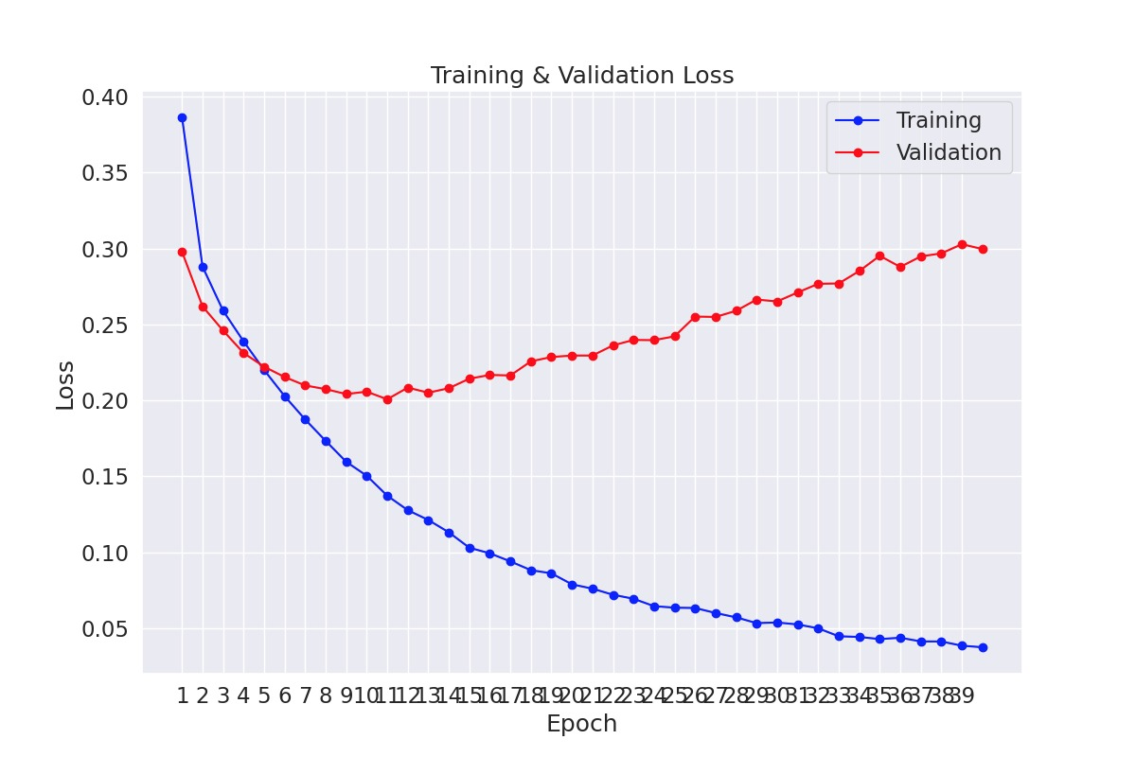
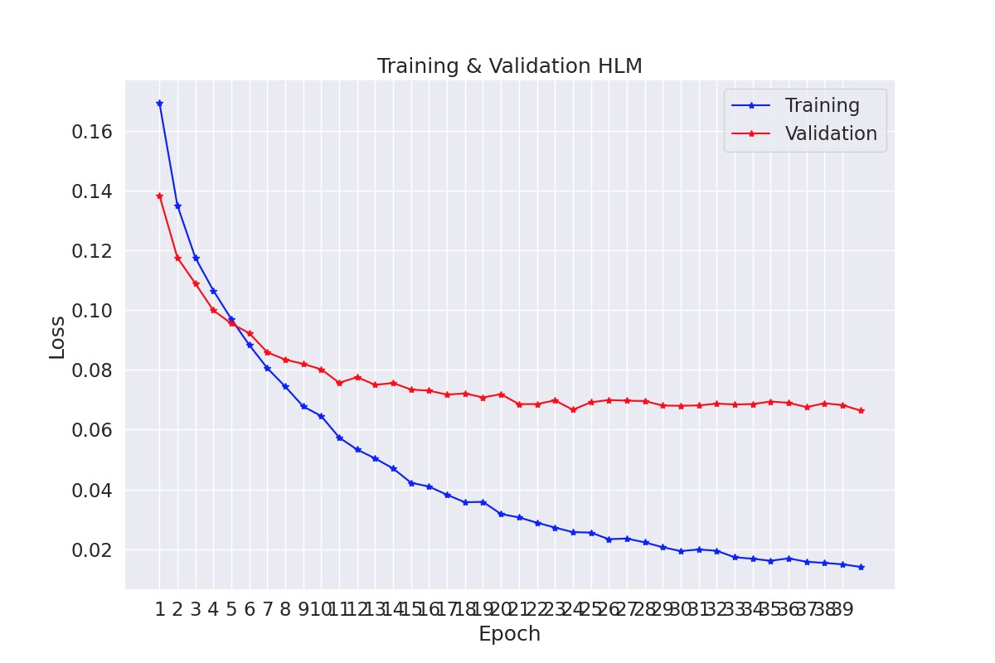
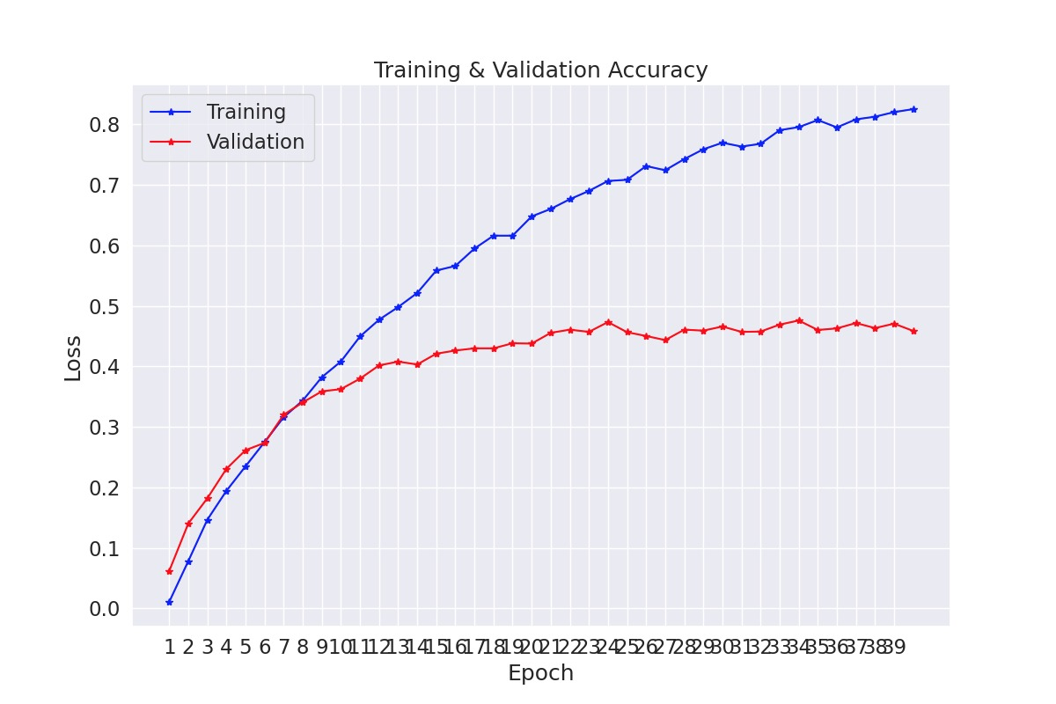
Efficient Net
Test Accuracy: 46% and Test Hamming: 0.06681
Average Individual Class – F1: 0.68

Slide 24
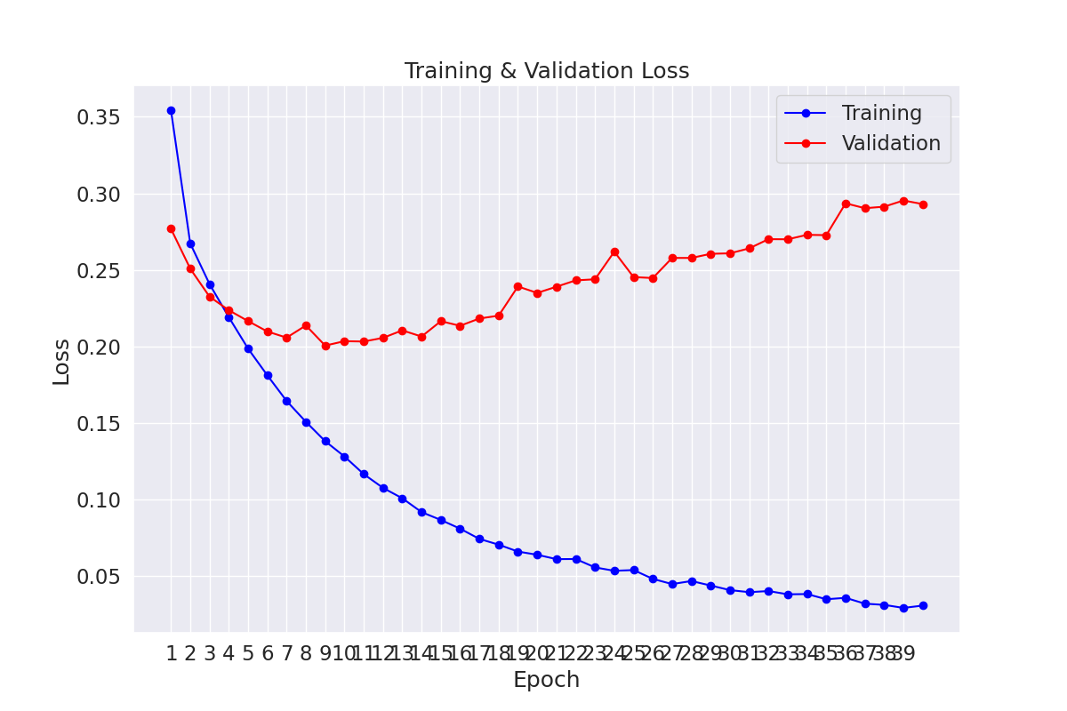
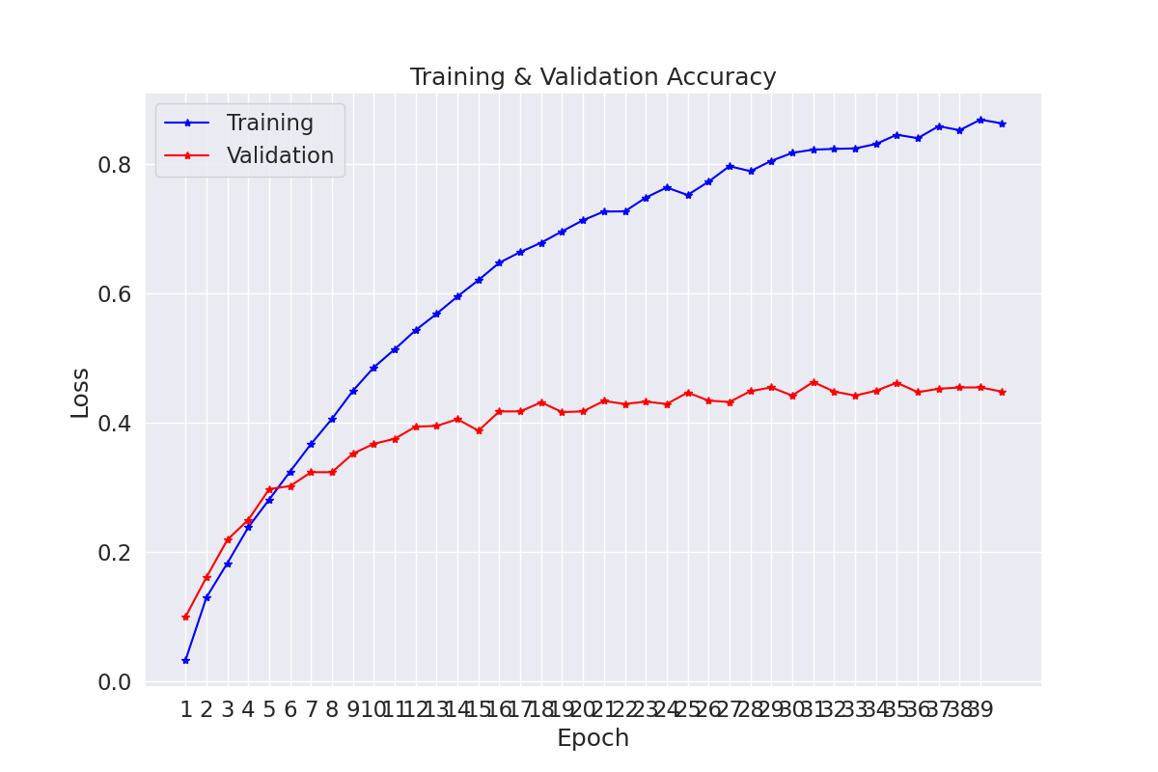
Reg Net
Test Accuracy: 45% and Test Hamming: 0.06623
Average Individual Class – F1: 0.67

Slide 25
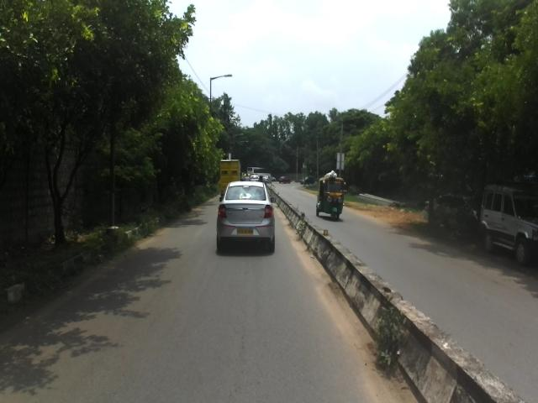
Results – Label Predictions
Predicted Labels: Rickshaw, Bus, Car, Rider, Truck, Bicycle, Traffic Sign

Slide 26
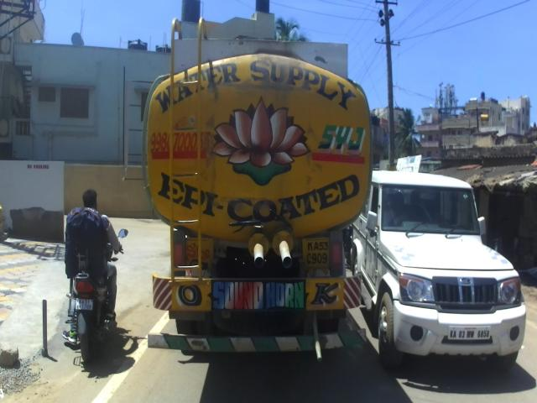
Results
Predicted Label: Bicycle, Car, Motorcycle, Rider, truck

Slide 27
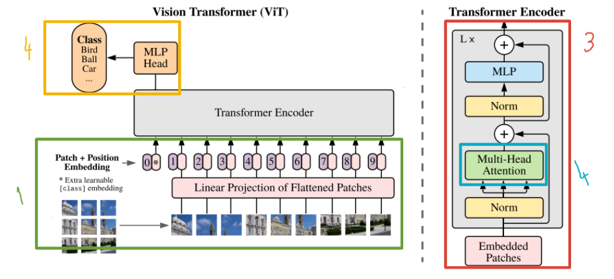
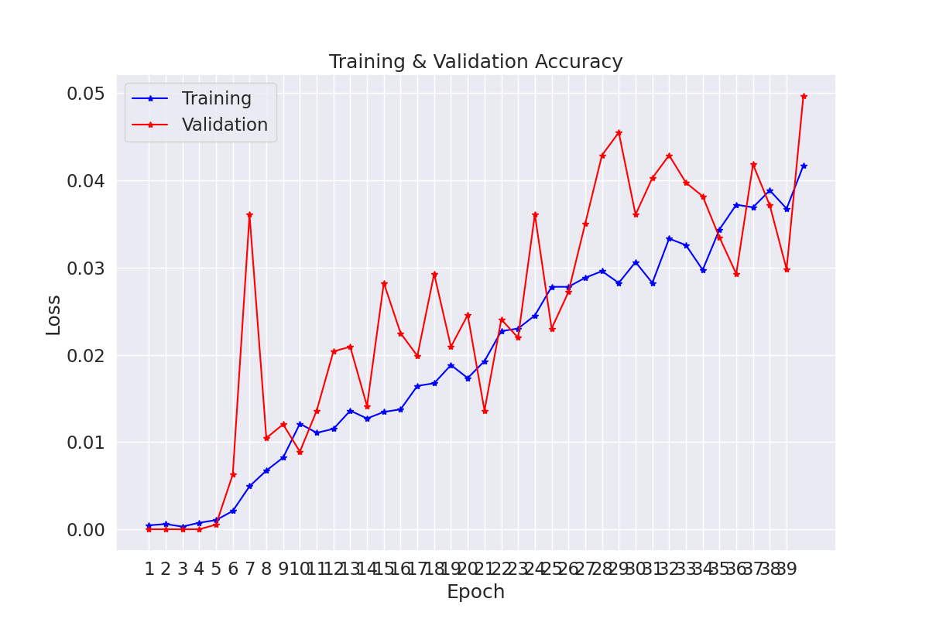
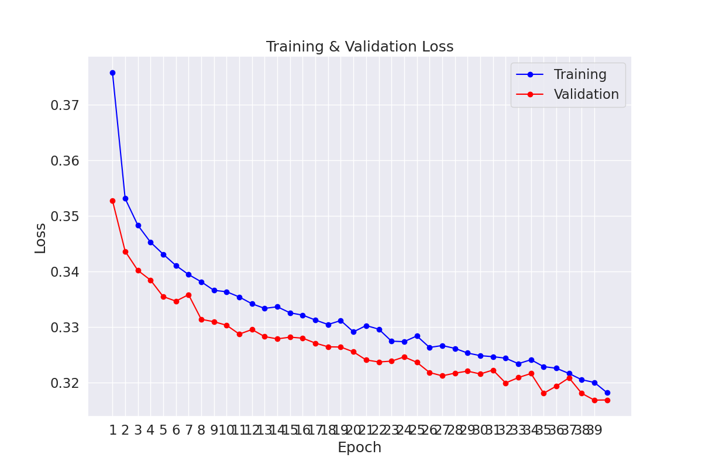
Future Work

